Slide 1


ATTITUDES OF UNDERGRADUATE PHARMACEUTICAL STUDENTS IN BAGHDAD TOWARD MENTAL DISORDERS AND PEOPLE WITH MENTAL HEALTH DIFFICULTIES
Ahmed Al-kashwan*
Numan Al-Harbi**
Background:
A major issue connected to societal biases, attitudes, and misconceptions including those
held by medical professionals is the stigma attached to mental health illnesses.
In the Arab world, not many studies have assessed medical students' perceptions of those
who struggle with mental health issues.
Understanding the attitudes and perceptions of undergraduate pharmaceutical students towards
mental health disorders is critical given the likelihood of their involvement in the treatment and care of such patients.
Aims:
The present study investigated the attitudes and opinions of pharmaceutical students in Baghdad regarding
mental health issues and those who suffer from them.
*Beladi scientific bureau
**Al-Kindi Medical center

Slide 2

ATTITUDES OF UNDERGRADUATE PHARMACEUTICAL STUDENTS IN BAGHDAD TOWARD MENTAL DISORDERS AND PEOPLE WITH MENTAL HEALTH DIFFICULTIES
Methods:
A random selection of 4th and 5th year students from the college of pharmacy in Ashur university in Baghdad
were asked to complete a two-part survey containing sociodemographic information and the Beliefs Towards
Mental Illness Scale.
Sociodemographic information:
Out of seventy students, fifty completed the survey.
Ranging in age from 20 to 26 (M=22)
32(64%) women and 18(36%) men, 90% were from Baghdad.
Here are the results.
Ahmed Al-kashwan
Numan Al-Harbi

Slide 3
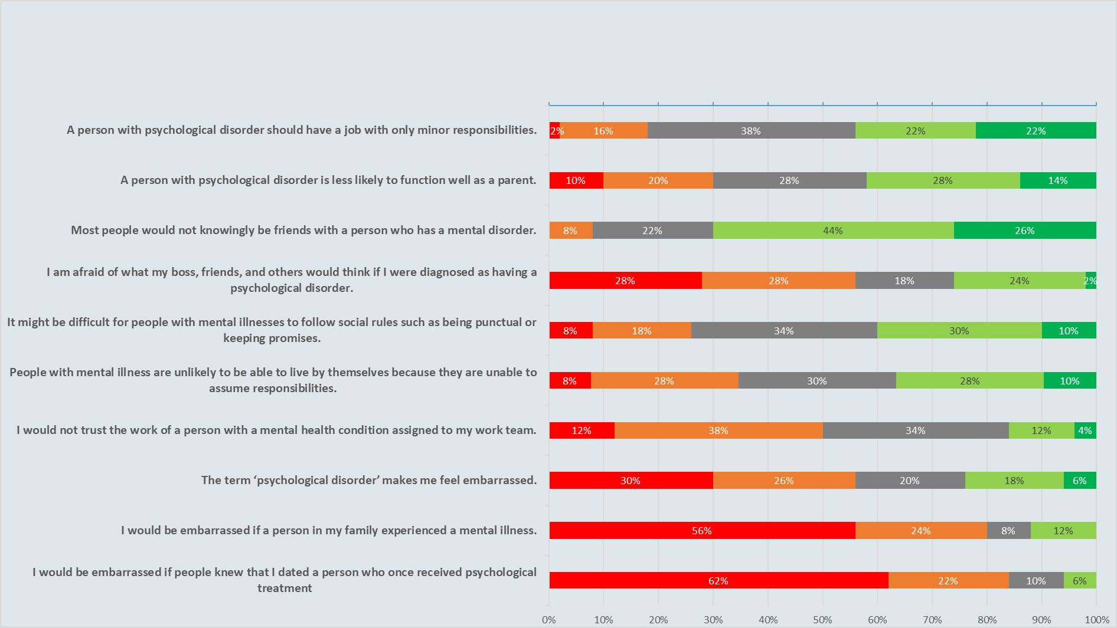
Social and Interpersonal Skills
completely disagree
Disagree
Neutral
Agree
Completely agree

Slide 4
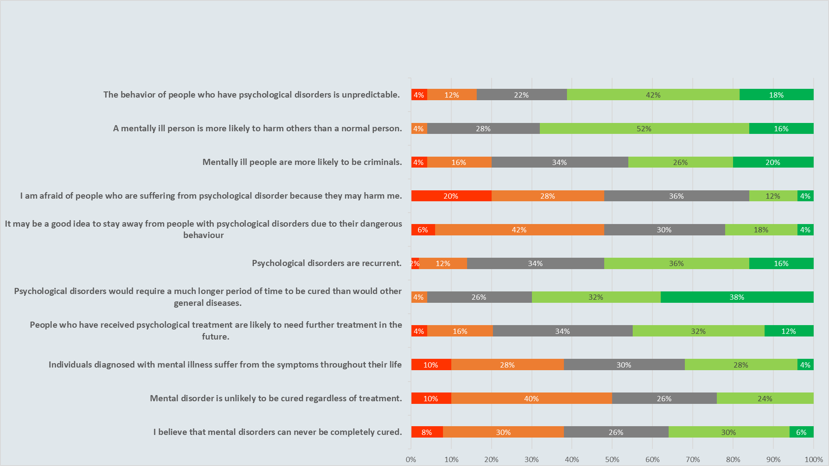
Dangerousness and Incurability
completely disagree
Disagree
Neutral
Agree
Completely agree

Slide 5
ATTITUDES OF UNDERGRADUATE PHARMACEUTICAL STUDENTS IN BAGHDAD TOWARD MENTAL DISORDERS AND PEOPLE WITH MENTAL HEALTH DIFFICULTIES
Results:
According to the findings, students would not feel ashamed about dating (84%) or having a family member (80%)
with a mental illness.
However, they also thought that mentally ill persons are more likely to harm others (68%)
and held negative views about the ability of those with mental illnesses as parents (42%) or coworkers (44%).
Also many believed that many mentally ill persons are more likely to become criminals (46%).
Conclusions:
Although most of the students did not see that mental illness is an embarrassment and were more accepting in their attitudes towards them, they still held deep rooted negative beliefs and fears about mental illnesses and people suffering from them.
reviewing course materials on mental illnesses and raising awareness could go some way in reducing the stigma, normalizing mental illnesses through proper education may also address the barrier that prevents undergraduates from seeking help, thus avoiding burnout.
Researchers and other professionals in the field also bear the responsibility of updating and removing any stigmatizing language from materials.

