Slide 1
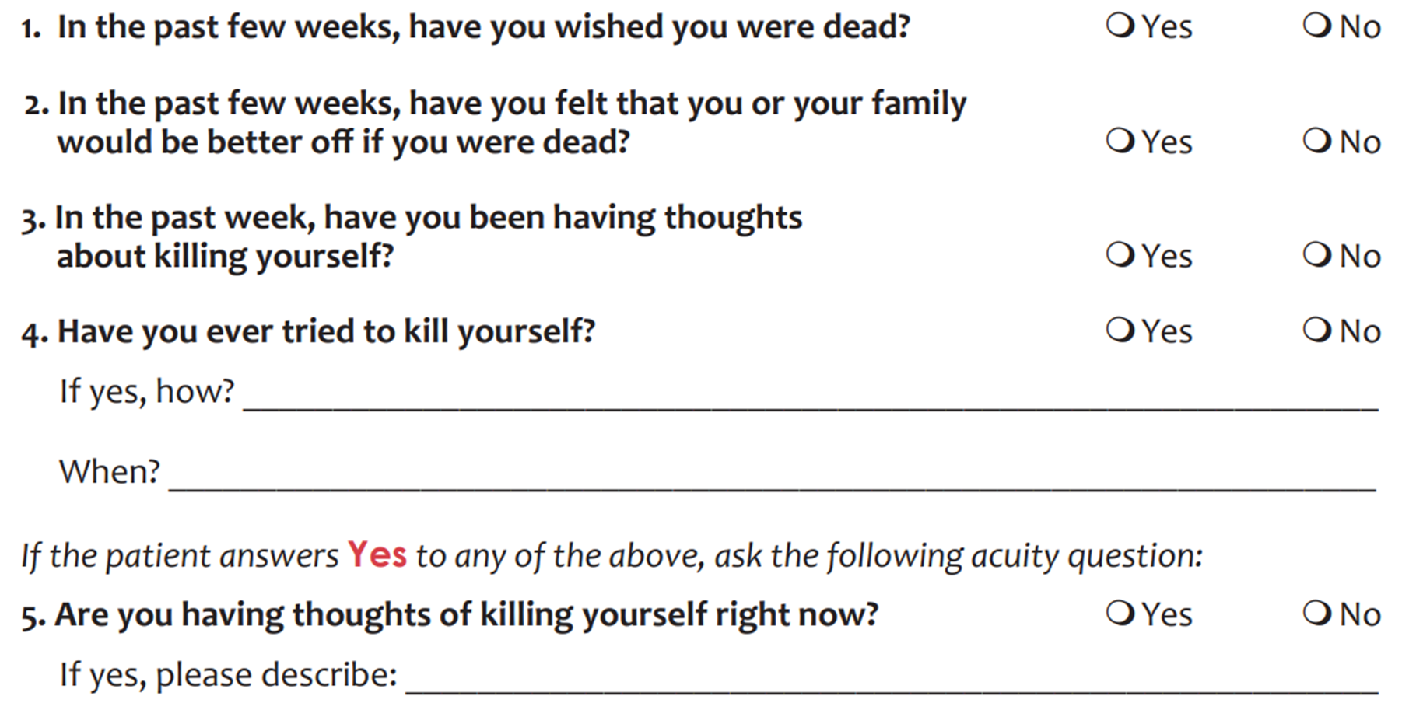
ADVANTAGES OF USING A SUICIDE RISK SCREENING TOOL IN CLINICAL PRACTICE
Initial Results of a 5-month Continuous Study to Evaluate a Novel Suicide Risk Screening Instrument in Hungary
Authors: Selma Kacimi El Hassani¹, David Szokolay¹, Eszter Palocz¹, Aranka Miklosi¹, Livia Priyanka Elek³, Brigitte Biro³, Mark Berdi², Xenia Gonda^{3,4}
¹Institute of Psychology, Faculty of Education and Psychology, Eotvos Lorand University Budapest, Hungary
²Institute of Psychology, University of Pecs, Pecs, Hungary
³Department of Psychiatry and Psychotherapy, Semmelweis University, Budapest, Hungary
⁴Department of Clinical Psychology, Semmelweis University, Budapest, Hungary
INTRODUCTION
ASQ (Ask Suicide Questionnaire) [4]
SAMPLE
2019 - more that 700.000 people died by suicide worldwide [1]
2023 - 1593 people died by suicide in Hungary [2]
Suicide is the fourth leading cause of death worldwide [1]
20% of people who die by suicide have consulted a mental health professional prior to their death [3]
5-item suicide risk screening tool
Data collection for this study is still in progress, but in the following, we will present data collected in one of our research centres where data collection has already been completed.
It can be used in both non-clinical (e.g. GP practice) and clinical settings on patients across all age groups
General psychiatry and crisis intervention unit of Peterfy Sandor Hospital (Budapest, Hungary)
All patients who are able to participate in the study (e.g. no cognitive impairment) and who accept the conditions of participation
Between July and November 2024
Effective screening is is crucial for early identification and intervention
RESULTS
 | ASQ RESULT (N=113)
 | ACUTE POSITIVE (n=12, 10.62%) |  | NON-ACUTE POSITIVE (n=72, 63.72%) |  | NEGATIVE (n=29, 25.66%)
 | n | % | n | % | n | %
Previous inpatient care | 9 | 75.00% | 44 | 61.11% | 23 | 79.31%
Suicide attempt in the familial anamnesis | 5 | 40.66% | 29 | 40.28% | 6 | 20.69%
Completed suicide in familial anamnesis | 1 | 8.33% | 17 | 23.61% | 6 | 20.69%
Diagnosed with mood disorder | 8 | 66.66% | 44 | 61.11% | 22 | 75.86%
Diagnosed with personality disorder | 5 | 41.66% | 17 | 23.61% | 6 | 20.69%
Diagnosed with schizophrenia | 0 | 0% | 6 | 8.33% | 4 | 13.79%
Diagnosed with substance abuse | 5 | 41.66% | 24 | 33.33% | 9 | 31.03%
Diagnosed with anxiety disorder | 1 | 8.33% | 5 | 6.94% | 4 | 13.79%
It is crucial that mental health professionals have the right tools to screen and assess suicide risk
MEN
WOMEN
POSSIBLE ASQ RESULTS
M_{age} = 43
(SD = 17.37, Min = 18, Max = 94)
OBJECTIVE
ACUTE POSITIVE
NON-ACUTE POSITIVE
NEGATIVE
Provide insight into the Hungarian validity study of the ASQ and data gathered during the research
Demonstrate the benefits of incorporating a risk screening tool into the clinical (or even non-clinical) practice
FULL PSYCHIATRIC & SAFETY EVALUATION
FURTHER ASSESMENT USING BSSA
NO FURTHER STEPS ARE NEEDED*
METHODS
*But stay alert for the warning signs of suicide.
BSSA (Brief Suicide Safety Assessment) [5]
Since there is almost no validated brief suicide risk screening instrument available in Hungary, we set out to conduct a validity study of the Hungarian adaptation of ASQ.
Assessment guide for clinicians that helps to choose an appropriate disposition plan
VALIDATION PROCESS
DISCUSSION
1
2
ASQ (& test battery covering different patient factors)
BSSA (gold standard)
Using the ASQ would make it possible to conclude in a real clinical setting for a quarter of patients that no further action is needed in their case
Long-term plan: develop ASQ training to facilitate its integration into clinical practice and make it a more widely used suicide screening tool in Hungary
REFERENCES
[1] World Health Organization. (2021). Suicide worldwide in 2019: global health estimates.
[2] Hungarian Central Statistical Office. Halálozások száma és aránya, csecsemőhalandóság, születéskor várható élettartam, halálozás főbb okok szerint. https://www.ksh.hu/stadat_files/nep/hu/nep0009.html
[3] Ahmedani, B. K., Simon, G. E., Stewart, C., Beck, A., Waitzfelder, B. E., Rossom, R., ... & Solberg, L. I. (2014). Health care contacts in the year before suicide death. Journal of general internal medicine, 29, 870-877.
[4] Horowitz, L. M., Bridge, J. A., Teach, S. J., Ballard, E., Klima, J., Rosenstein, D. L., ... & Pao, M. (2012). Ask Suicide-Screening Questions (ASQ): a brief instrument for the pediatric emergency department . Archives of Pediatrics & Adolescent Medicine, 166(12), 1170-1176.
[5] Ayer, L., Horowitz, L. M., Colpe, L., Lowry, N. J., Ryan, P. C., Boudreaux, E., ... & Schoenbaum, M. (2022). Clinical pathway for suicide risk screening in adult primary care settings: special recommendations. Journal of the Academy of Consultation-liaison Psychiatry, 63(5), 497-510.

