Slide 1
The Mobile Mental Health Unit of adults in Veria: Current challenges
Maria Sofologi¹, Xristina Koutsoudi¹, Elena Papadopoulou¹, Theofilos Varaklis^{1,} Athina Grigoriadou¹, Eleni Kafetzi¹, Meni Tsili¹ & Konstantinos Fountoulakis²
^{1.}Mobile Mental Health Unit of adults in Veroia
² Professor of Psychiatry, Aristotle University of Thessaloniki, Greece

Slide 2
The Mobile Mental Health Unit of adults in Veria
Community mental health services offer a broad range of services for all mental disorders, with the emphasis being placed on long-term, severe mental illnesses, such as psychoses
Since the foundation of the first MMHUs in the eighties till nowadays, those services have expanded in many rural areas and there is some evidence that they are effective in the management of patients with severe mental disorders

Slide 3
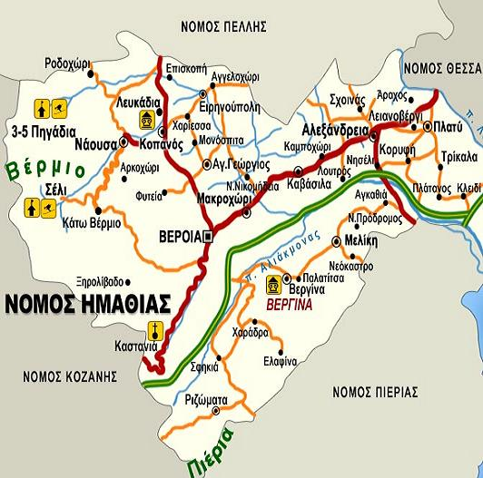
The Mobile Mental Health Unit (MMHU) of Veria of the Society of Social Psychiatry E.N.A. operate based on the principles of social Psychiatry, within the local community and in close cooperation with it The MMHU of Veria is located in the Prefecture of Imathia (Central Makedonia)

Slide 4
The Mobile Mental Health Unit of adults inVeria
The basic aims of the Mobile Unit are:
The prevention, the diagnosis and the treatment of mental health disorders for adults
The promotion of the population’s mental health
The rehabilitation, the social and employment inclusion of people with psychosocial problems
The protection of the patients’ rights
Crisis intervention and support provision at the patient’s home
The education and training of mental health professionals and other local groups at the community
Awareness-raising and sensitisation of the population on mental health issues

Slide 5
The Mobile Mental Health Unit of adults inVeria
Psychotherapeutic Sessions from April 2023 up to January 2025 |  | Percentage
Women Sessions | 2239 | 79,26%
Men Session | 586 | 20,74%
Total | 2825
Sessions in Health center of Veria | 2093 | 74,09%
Session in Health center of Alexandria | 288 | 10,19%
Session in Health center of Naoussa | 293 | 10,37%
Home sessions | 151 | 5,35%
Total | 2825

Slide 6
The Mobile Mental Health Unit of adults inVeria
Thank you

