Slide 1
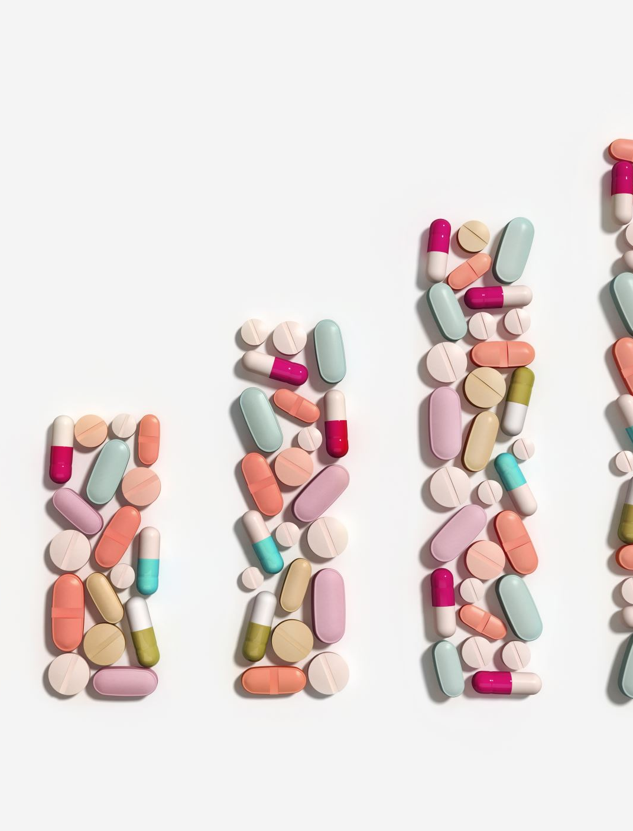
SELF-EFFICACY AND PERCEIVED SELF-EFFICACY AS PREDICTORS OF MEDICATION ADHERENCE IN PATIENTS WITH MENTAL DISORDERS
Olga Velentza 1 , Maria Topi 2 , Sophia Zyga 3 , Foteini Tzavella 4 , Aspasia Panagiotou 5
1. Rn MSc PhDc, Eginiteio Hospital, Athens, Greece
2. Rn MSc Phd, Eginiteio Hospital, Athens, Greece
3. Professor, Nursing Department, University of Peloponnese, Greece
4. Substitute Professor, Nursing Department, University of Peloponnese, Greece
5. Assistant Professor, Nursing Department, University of Peloponnese, Greece

Slide 2
Compliance, according to Hamrahian (2020), is the process in which patients take their medications based on medical instructions, and it is divided into three phases: (1) initiation, (2) implementation, and (3) discontinuation. Compliance behavior can change and fluctuate over time and throughout the progression of the disease (Kane et al., 2013). Human behavior is central to maintaining health and preventing disease. Individuals are more likely to be motivated and engage in compliant behavior if their self-efficacy is high (Lopez et al., 2003). Self-efficacy is defined as an individual’s perception of their ability to perform specific behaviors through four processes, including cognitive, motivational, affective, and choice processes (Bandura, 1997; Connolly, Aitken, & Tower, 2013). Perceived self-efficacy plays a critical role in determining an individual's level of motivation (Molteni et al., 2014).
Introduction
Objective & Methods
The purpose of this study was to investigate, through a comprehensive literature review, the extent to which self-efficacy and perceived self-efficacy contribute to medication adherence among individuals with mental disorders.
A systematic review of the literature was conducted using electronic databases, including Google Scholar, PubMed, and Scopus. Studies and articles published in Greek and English that addressed self-efficacy as a predictive factor in medication adherence among mentally ill patients were identified and selected.

Slide 3
Results
The literature review indicates that a high sense of self-efficacy is associated with improved health outcomes, enhanced achievement, and better social inclusion (Scholz et al ., 2002).
Additionally, self-efficacy has been identified as a foundational element of medication adherence in chronic mental illnesses and serves as the most critical factor influencing compliance within various contexts in social cognitive theories and self-regulation (McCann et al., 2008; Holmes et al., 2014).
A review of 66 articles (Johnson et al., 2006; Warren-Findlow et al., 2011) revealed that 59 studies found a positive correlation between medication adherence self-efficacy and compliance.
Furthermore, perceived self-efficacy was generally positively correlated with adherence, as highlighted in research conducted by Corless et al. (2012) and Valeberg et al. (2008).
Some studies employed both general self-efficacy measures and disease- or medication-specific measures to determine which was more predictive of self-reported adherence to medication. Two of these studies indicated that disease self-efficacy was a stronger predictor of adherence than perceived self-efficacy.
The review by McCann et al. (2008) underscored the significance of self-efficacy in medication adherence among individuals with chronic mental illnesses, demonstrating that self-efficacy is a crucial predictor of adherence in both mental and physical health contexts.
The influence of self-efficacy on promoting adherence is notably robust, maintaining its relevance across different types of self-efficacy and various medical conditions.
Conversely, specific measures of both medication adherence self-efficacy and disease management self-efficacy exhibited a stronger positive association with adherence compared to general self-efficacy.

Slide 4
Studies examining the compliance of psychiatric patients and their perceived self-efficacy indicate a significant correlation between self-efficacy, medication adherence, and self-management. The results suggest that self-efficacy, along with quality of life and social functioning, constitutes critical self-factors influencing medication adherence among patients with mental disorders. Moreover, our research supports the assertion that self-efficacy is a robust predictor of medication adherence. This positive association is evident across various types of self-efficacy, including general self-efficacy, medication adherence, disease management, and other domain-specific measures (Holmes et al., 2014).
Conclusions

Slide 5
References
Bandura, A. (1977). Self-efficacy: Toward a unifying theory of behavioral change. Psychological Review, 84(2), 191-215.
Bandura A. Social cognitive theory: an agentic perspective. Annu Rev Psychol. 1999;2(1):21–41.
Donavan JL., Blake D.R., (1992) “Patient non-adherence: Deviance or reasoned decision- Making? Social Science and Medicine, Vol. 34(5), p.p:507-513.
Hamrahian, S. Mehrdad. 2020. “Medication Non-Adherence: A Major Cause of Resistant Hypertension.” Current Cardiology Reports 22 (11): 133. https://doi.org/10.1007/s11886-020-01400-3.
Holmes EA, Hughes DA, Morrison VL. (2014), Predicting Adherence to Medications Using Health Psychology Theories: A Systematic Review of 20 Years of Empirical Research. Value Heal. 2014;17(8):863–76.
Haynes RB., Taylor DW., Sackett DL., (1979) Adherence in health care Md, johns Hopkins University Press, Baltimore.
Kane JM, Kishimoto T, Correll CU (2013) Non-adherence to medication in patients with psychotic disorders: epidemiology, contributing factors and management strategies. World Psychiatry 12:216–226.
McQuaid, Elizabeth L., and Wendy Landier. (2018). “Cultural Issues in Medication Adherence: Disparities and Directions.” Journal of General Internal Medicine 33 (2): 200–206. https://doi.org/10.1007/s11606-017-4199-3.
Valeberg BT, Miaskowski C, Hanestad BR, Bjordal K, Moum T, Rustøen T. (2008), Prevalence rates for and predictors of self-reported adherence of oncology outpatients with analgesic medications. Clin J Pain. 2008;24(7):627–36.

