Slide 1
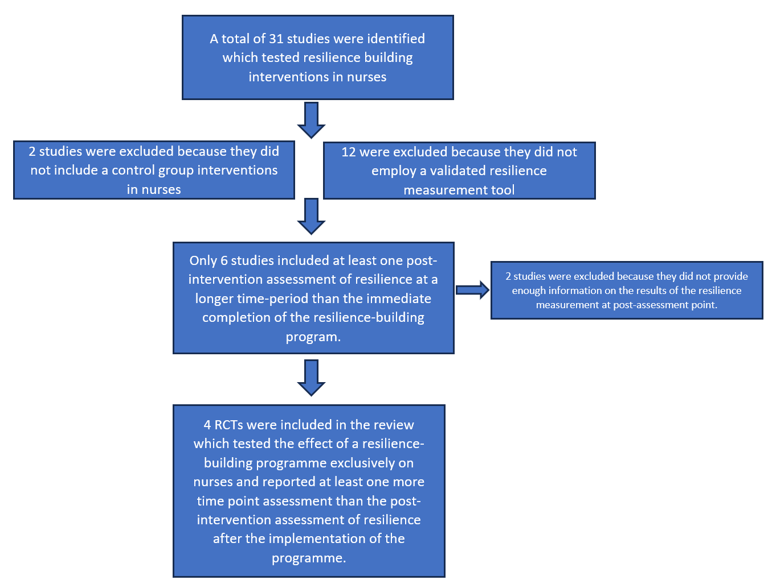
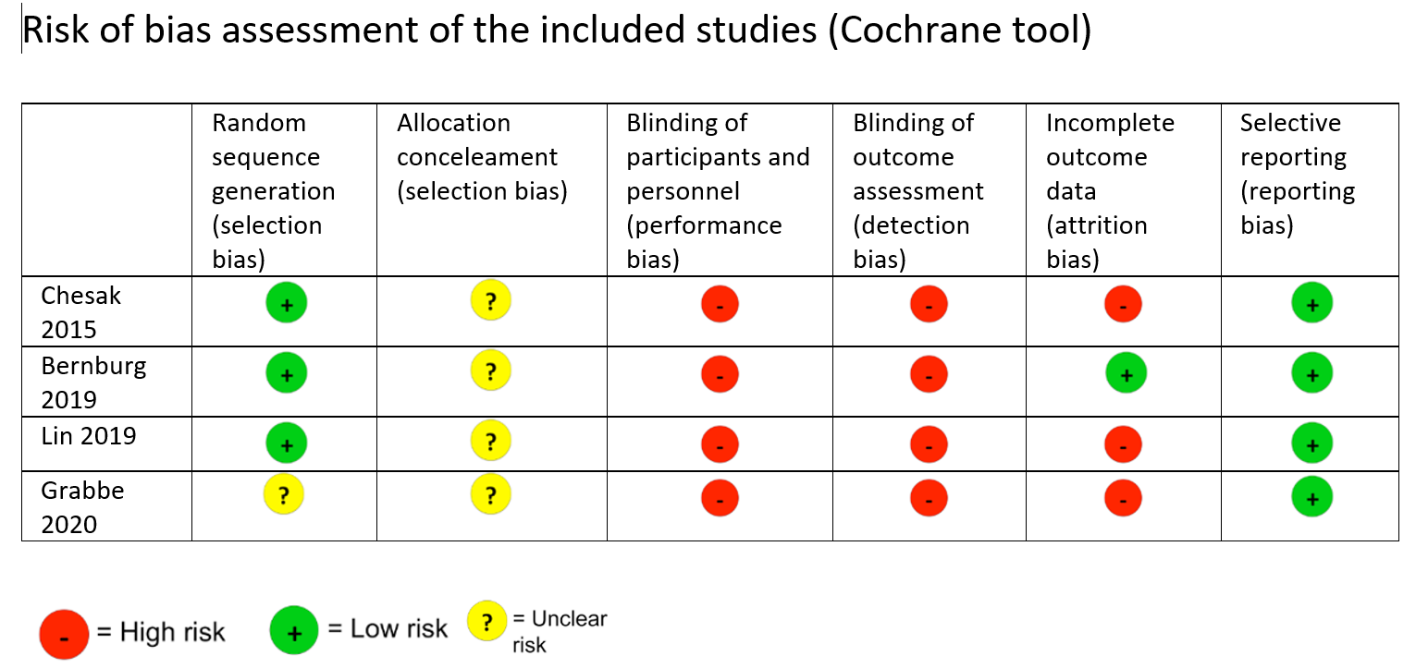
\
The long-term impact of resilience-building interventions in nurses: A review of the evidence
Karanikola Maria, Kyranou Maria Department of Nursing, School of Health Sciences, Cyprus University of Technology
STRATEGY
What is known about this topic
Optimal mental health is of paramount importance for healthcare providers.
Numerous systematic reviews point to the need for interventions to foster resilience in nurses.
The impact of these interventions remains doubtful in terms of magnitude and lasting duration.
SEARCH STRATEGY
A systematic literature search between August and January of 2022 was conducted.
Key-terms/Databases: “Resilience/Psychological, Adaptation/Psychological, nurses, randomized controlled trial” in the EBSCOhost, MEDLINE ProQuest, Google Scholar, PubMed, and Scopus databases.
Inclusion Criteria: Randomised controlled trials (RCTs), English language, no chronological limitations, including at least two time point post-intervention for the assessment of resilience.
Exclusion Criteria: Studies that exclusively used well-being or mental-health outcomes as the main measure of resilience, use of a non-validated tool for the measure of resilience.
RESULTS
Theoretical Underpinnings and Aim of the study
New conceptual approaches suggest that resilience is best viewed as one possible OUTCOME of adaptation after acute severe or chronic stress exposure.
What defines the outcome is the INTERACTION between characteristics of the individual and their environment (Kalish 2019).
the AIM of the study was to review which interventions work towards resilience in the long term for nurses.
SEARCH STRATEGY
DISCUSSION
We found that even when resilience-building interventions in healthcare professionals result in higher levels of resilience immediately after the end of the intervention, they appear to fail to improve well-being in the long term (similar to Kunzler et al., 2020, 2022).
Lack of studies with assessments of individual risk for the development of mental disorders before and after serious stress exposure (Vanhove et al., 2016)
Despite resilience being viewed as a process that unfolds over time (Galatzer-Levy, 2018) studies on nurses do not collect longitudinal data.
Contact:
Maria Karanikola: maria.Karanikola@cut.ac.cy
Maria Kyranou: maria.Kyranou@cut.ac.cy
References available upon request

