Slide 1
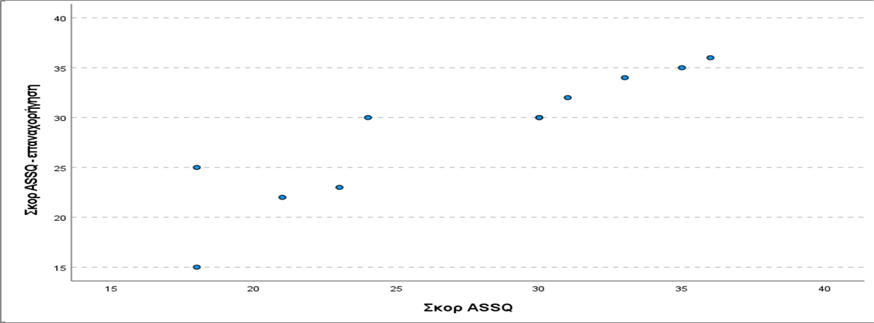
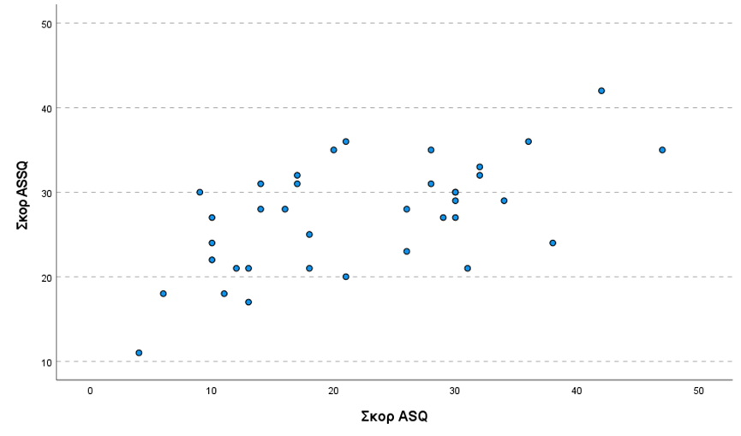
Autism Spectrum Quotient-Adolescent (ASQ-A) and the Autism Spectrum Screening Questionnaire (ASQ) in Greek: A preliminary validation study
Christina Tsortanidou¹, Olga Chrysostomidou¹, Vasiliki Zarokanellou¹, Dionysios Tafiadis¹, Alexandros Gryparis¹
¹ Department of Speech-Language Therapy, University of Ioannina
ABSTRACT
INTRODUCTION
RESULTS
Background and goals of the study: The Autism Spectrum Quotient (ASQ) and the Autism Spectrum Screening Questionnaire (ASSQ) are two self-reported questionnaires that have been used broadly for the identification of autistic traits in individuals at risk for ASD. The present study aims to provide preliminary validation data for the Greek translation and adaptation of the ASQ and the ASSQ in adolescents.
Μethods: Participants were 39 adolescents aged 10;00 to 16;00 years old with a formal diagnosis of either ASD, Asperger's Syndrome, or Pervasive Developmental Disorder not otherwise specified according to ICD-10 criteria (WHO-1990). Participants were divided into two groups. The ASD group included 27 participants with autism diagnosis and the High-functioning ASD group included 12 participants with a formal diagnosis of Asperger’s syndrome or Pervasive Developmental Disorder not otherwise specified with normal intelligence according to their caregivers and teachers' reports. Children's primary caregivers completed the two questionnaires. 11 out of the 39 parents completed both questionnaires again after 15 days of initial administration.
Results: Both ASQ and ASSQ questionnaires showed acceptable internal consistency with a Cronbach’s alpha value of 0.745 and 0.799 respectively. Mann-Whitney test revealed a significant difference between the mean total scores in the ASQ (p=0.008) and the ASSQ (p<0.001) in the two groups of participants, with the Autism Group presenting significantly higher mean total scores in both questionnaires. A statistically significant moderate correlation (r=0.540) was observed between the ASQ and ASSQ. The test-retest reliability was excellent for both tools with a Spearman correlation coefficient equal to 0.982 (p<0.001) for ASQ and 0.954 (p<0.001) for the ASSQ. Conclusions: The above results indicate that these Greek versions of the ASQ and ASSQ questionnaires demonstrate acceptable psychometric properties and can be used to identify autistic traits in adolescents. Further research is needed in a larger sample of participants.
Until today there is no standardized tool for the screening of ASD traits in Greek-speaking children and adolescents aged 10 to 16 years old. By piloting a weighting study of the Autism Spectrum Quotient (ASQ, Cohen et al., 2006) and Autism Spectrum Screening Questionnaire (ASSQ, Ehlers et al., 1996), a first evaluation of the psychometric properties of the adapted Greek versions of these instruments is provided, offering an opportunity to explore their validity for Greek-speaking adolescents of this age.
The ASQ (Cohen et al., 1996) is a self-reported 50-item 4-Likert scale questionnaire that is standardized for ASD persons over 16 years old who have typical intelligence or present mild intellectual disability. This questionnaire in its original standardization presented excellent psychometric properties and until today it has been also translated, adapted, and validated in Dutch (Hoekstra et al., 2008), French (Kempenaers et al., 2017), Brazilian Portuguese (Costa Alves et al., 2020), Korean (Ko et al., 2018) and Polish (Pisula et al., 2013).
The ASSQ (Ehlers et al., 2006) is a 27-item easy-to-respond questionnaire that assesses autistic traits on a three-Likert scale, in which zero values typical behavior, one rather atypical behavior, and two serious disrupted behavior. The tool presents acceptable psychometric properties (sensitivity 0.62-0.91 %, specificity over 0.90%, and test-retest reliability 0.77) and it has been translated and validated also in Norwegian (Posserud et al., 2009), Mandarin Chinese (Guo et al., 2011), Finnish (Mattila et al., 2012) and Undu, which is official language of Pakistan (Saeed et al., 2022).
AIM: The present study aimed to provide preliminary validation data for the Greek translation and adaptation of the ASQ and the ASSQ in Greek-speaking ASD adolescents, aged 10 to 16 years old.
The ASQ-Adolescent version (Cohen et al., 2006) and the ASSQ (Ehlers et al., 1996) are reliable screening tools.
Both ASQ and ASSQ questionnaires showed acceptable internal consistency with a Cronbach’s alpha value of 0.745 and 0.799 respectively.
To assess internal consistency for each tool further, the overall Cronbach alpha value was calculated if each of the questions of the questionnaire was deleted. The statistical analysis revealed that the Cronbach alpha values generated were very close to the original Cronbach alpha value, indicating the high internal validity of both tools.
Mann-Whitney test revealed a significant difference between the mean total scores in the ASQ (p=0.008) and the ASSQ (p<0.001) in the two groups of participants, with the Autism Group presenting significantly higher mean total scores in both questionnaires.
A statistically significant moderate correlation (r=0.540) was observed between the ASQ and ASSQ questionnaires.
The test-retest reliability was excellent for both tools with a Spearman correlation coefficient equal to 0.982 (p<0.001) for ASQ and 0.954 (p<0.001) for the ASSQ.
Chart 2. Bar chart of the total score in the ASSQ questionnaire in the first and the second administration
DISCUSSION
Both these translated and adapted Greek versions of the questionnaires show acceptable psychometric properties and may be used for Greek-speaking children and adolescents aged 10 to 16 years. Limitations of the present study include the small number of ASD participants and the absence of a control group, which makes difficult the generalization of the findings of the present study in the general population.
 | Group | N | Mean | Median | SD | Min | MAX
ASQ | Typical autism | 27 | 26,0 | 28,0 | 9,96 | 9,0 | 47,0
 | High functioning | 12 | 15,7 | 12,5 | 9,49 | 4,0 | 31,0
 | Total | 39 | 22,9 | 21,0 | 10,82 | 4,0 | 47,0
ASSQ | Typical autism | 26 | 29,6 | 29,5 | 5,3 | 20,0 | 42,0
 | High functioning | 11 | 21,6 | 21,0 | 5,8 | 11,0 | 31,0
METHODS AND MATERIALS
Before the beginning of the study, a research license was obtained for the translation and adaptation of the questionnaires in Greek by the authors of the tools, and the study’s protocol was approved (Ethics Committee of University of Ioannina, No. 49623) by the Ethics Committee of the University of Ioannina. Participants were 39 primary caregivers of adolescents with ASD, who had received a formal diagnosis of autism, Asperger’s syndrome or Pervasive Developmental Disorder unspecified according to ICD-10 criteria (WHO, 1990). All ASD participants were monolingual Greek-speaking adolescents between 10 and 16 years old, who attended regular high school or Special education elementary school and lived with their families. The questionnaires were distributed in paper or via email through the teachers of participants and caregivers could complete them and send them back within a week time. From the 39 participants, 12 had received a diagnosis for Asperger syndrome or Pervasive Developmental Disorder not otherwise specified and they consisted the High-Functioning ASD group, while the rest 27 had received a formal diagnosis of infantile autism, constituting the typical autism Group. 11 out of 39 primary caregivers accepted to complete again both questionnaires after 15 days in order to test the reliability of the instruments.
For the statistical analysis, the software SPSS28.0 was used. Qualitative variables are expressed as absolute and relative (%) frequencies, while quantitative variables are expressed as mean and standard deviation (SD). The normality assumption was evaluated using the Shapiro–Wilk test. To investigate relationships between qualitative variables, the chi-square test was used, while to compare quantitative variables between the two groups, the Mann-Whitney test was implemented. Spearman’s correlation coefficient was used to examine the correlation between two quantitative variables.
CONTACT
Table 1. Descriptive statistics for the results in the ASQ and ASSQ questionnaires, in the two groups of participants
CONCLUSIONS
Christina Tsortanidou/Olga Christostomidou
Department of Speech-Language Therapy,
University of Ioannina
Email: slt01011@uoi.gr, slt00990@uoi.gr
In conclusion, the statistical analysis shows that both tools have good internal validity, as well as high-reliability rates.
Regarding the comparison made between the two study groups (High-Functioning ASD Group and Typical Autism Group), statistically significant differences emerged, indicating that people with infantile autism tend to demonstrate more autistic traits than people with high-functioning autism.
REFERENCES
Ehlers, S., Gillberg, C., & Wing, L. (1999). A screening questionnaire for Asperger syndrome and other high-functioning autism spectrum disorders in school age children. Journal of autism and developmental disorders, 29, 129-141.
Baron-Cohen, S., Hoekstra, R. A., Knickmeyer, R., & Wheelwright, S. (2006). The autism-spectrum quotient (AQ)—adolescent version. Journal of autism and developmental disorders, 36, 343-350.
Chart 1. Bar chart of the total score in the ASSQ questionnaire in relation to the total
score on the ASQ questionnaire.

