Slide 1
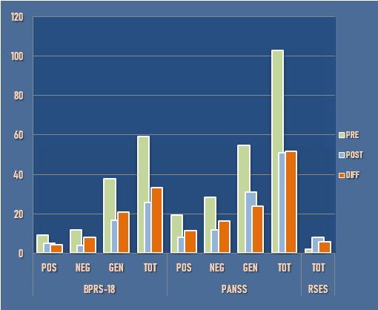
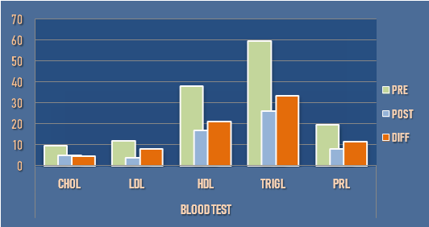
EFFECTIVENESS OF CARIPRAZINE AS ADJUNCTIVE TREATMENT IN A COMPLEX FORENSIC PSYCHIATRY CASE
A CASE REPORT
Angos P, Draga M, Triantafyllou T, Markopoulou M
Department of Forensic Psychiatry, Psychiatric Hospital of Thessaloniki, Greece
BACKGROUND: This case report evaluates cariprazine as adjunctive treatment in a 26-year-old male. The patient, a forensic psychiatry case, with a history of patricide, presented with a complex psychiatric profile, including symptoms of psychosis (F29), mood instability, and epilepsy (G40),and a history of violent behavior. Treatment at admission involved:
● olanzapine ● valproic acid ● diazepam ● paroxetine ● mirtazapine ● metoprolol ● biperiden ●
RESULTS:
Following the introduction of cariprazine, significant improvements were observed in psychiatric symptom severity, as evidenced by reductions in BPRS-18 and PANSS scores. Specifically, scores on the BPRS-18 Positive, Negative, and General subscales decreased by 47%, 67%, and 55%, respectively, while PANSS scores showed reductions of 59% (Positive), 58% (Negative), and 44% (General). The total scores for both scales also demonstrated substantial improvement, with reductions of 56% (BPRS-18) and 50% (PANSS) (table 1). Furthermore, the patient experienced improvements in blood pressure (-4%), body weight (-2%), and various blood parameters, particularly in cholesterol levels (table 2).
TABLE 1
METHODS:
12 months after admission, cariprazine was introduced as adjunctive therapy, leading to the discontinuation of olanzapine and paroxetine.
Psychiatric symptom severity was assessed using validated scales, including the Brief Psychiatric Rating Scale (BPRS-18) the Positive and Negative Syndrome Scale (PANSS) and the Rosenberg Self-Esteem Scale (RSES), before and after the initiation of cariprazine.
Additionally, vital signs, body weight, and laboratory parameters were monitored throughout the novel treatment period.
CONCLUSION:
Cariprazine adjunctive therapy effectively reduced psychiatric symptom severity and improved clinical outcomes in this complex forensic psychiatry case involving patricide.
These findings underscore the potential utility of cariprazine as a valuable treatment option for individuals with refractory psychiatric disorders and comorbid epilepsy.
Further research is warranted to explore the long-term efficacy and safety of cariprazine in similar clinical populations.
TABLE 2
REFERENCES: 1. Edinoff A, Ruoff MT, Ghaffar YT, et al. Cariprazine to Treat Schizophrenia and Bipolar Disorder in Adults. Psychopharmacol Bull. 2020;50(4):83-117. | 2. Garnock-Jones KP. Cariprazine: A Review in Schizophrenia. CNS Drugs. 2017;31(6):513-525. doi:10.1007/s40263-017-0442-z. | 3. Laszlovszky I, Barabássy Á, Németh G. Cariprazine, A Broad-Spectrum Antipsychotic for the Treatment of Schizophrenia: Pharmacology, Efficacy, and Safety. Adv Ther. 2021;38(7):3652-3673. doi:10.1007/s12325-021-01797-5. | 4. Mucci F, Della Vecchia A, Baroni S, Marazziti D. Cariprazine as a therapeutic option for schizophrenia: a drug evaluation. Expert Opin Pharmacother. 2021;22(4):415-426. doi:10.1080/14656566.2020.1845315. | 5. Fagiolini A, Alcalá JÁ, Aubel T, et al. Treating schizophrenia with cariprazine: from clinical research to clinical practice. Real world experiences and recommendations from an International Panel. Ann Gen Psychiatry. 2020;19:55. Published 2020 Sep 26. doi:10.1186/s12991-020-00305-3. | 6. Misiak B, Bieńkowski P, Samochowiec J. Cariprazine - a novel antipsychotic drug and its place in the treatment of schizophrenia. Psychiatr Pol. 2018;52(6):971-981. doi:10.12740/PP/OnlineFirst/80710.

