Slide 1
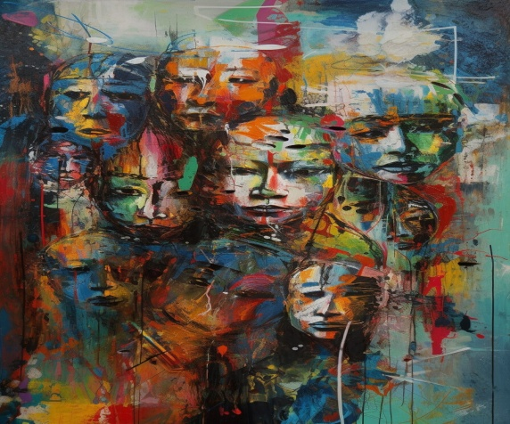
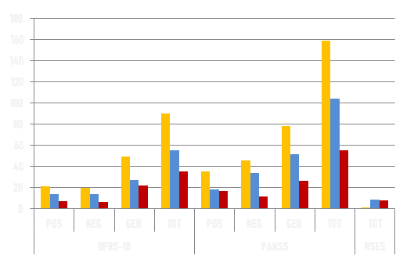
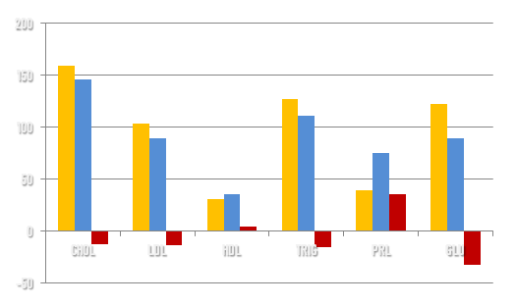
EFFECTIVENESS OF LURASIDONE AS ADJUNCTIVE TREATMENT IN A CASE OF SCHIZOPHRENIA
A FORENSIC PSYCHIATRY CASE REPORT
Draga M, Angos P, Triantafyllou T, Markopoulou M
Department of Forensic Psychiatry, Psychiatric Hospital of Thessaloniki, Greece
BACKGROUND: This report evaluates the efficacy of LURASIDONE as adjunctive therapy in a 57-year-old male patient diagnosed with schizophrenia and a history of forensic psychiatry involvement.. Treatment at admission involved:
● haloperidol ● quetiapine ● diazepam ● biperiden ● amlodipine ● irbesartan ●
RESULTS:
Following the LURASIDONE initiation, significant improvements in psychiatric symptoms were noted. BPRS scores decreased from 91 to 55, reflecting a 39% reduction in total symptom severity.
Subscale analysis revealed decreases of 33%, 33%, and 44% in positive, negative, and general symptom scores, respectively. PANSS scores also showed improvement, with reductions of 47% in positive symptoms, 26% in negative symptoms, and 34% in general psychopathology. Notably, improvements were observed in mood, behavior, and cognitive functioning. [table 1]
The pressure ulcers he exhibited due to prolonged bedrest were healed. Vital signs stabilized, with a minor increase in blood pressure, while reductions in weight were observed alongside improvements in lipid profile parameters and laboratory markers. [table 2]
table 1
METHODS:
2 months after admission, LURASIDONE 74mg QD was introduced as adjunctive therapy, alongside adjustments to quetiapine (200mg > 100mg), biperiden (2mg > 4mg), and irbesartan (150mg > 75mg) daily doses.
Psychiatric symptom severity was assessed using validated scales, including the Brief Psychiatric Rating Scale (BPRS-18) the Positive and Negative Syndrome Scale (PANSS) and the Rosenberg Self-Esteem Scale (RSES), before and after the initiation of LURASIDONE.
Additionally, vital signs, body weight, and laboratory parameters were monitored throughout the novel treatment period.
CONCLUSION:
The addition of LURASIDONE as adjunctive therapy in this patient with schizophrenia and a history of forensic psychiatry involvement led to significant improvements in psychiatric symptomatology and overall clinical outcomes.
These findings highlight the potential efficacy of LURASIDONE as an adjunctive treatment option for schizophrenia, particularly in patients with inadequate response to conventional antipsychotics, especially but not exclusively regarding negative symptoms.
Further investigation is warranted to elucidate the long-term effectiveness and safety profile of LURASIDONE in similar clinical contexts.
table 2
REFERENCES: Miura, I., Horikoshi, S., Ichinose, M., Suzuki, Y., & Watanabe, K. (2023). Lurasidone for the Treatment of Schizophrenia: Design, Development, and Place in Therapy. Drug design, development and therapy, 17, 3023–3031. https://doi.org/10.2147/DDDT.S366769. | Tarzian, M., Soudan, M., Alhajji, M., Ndrio, M., & Fakoya, A. O. (2023). Lurasidone for Treating Schizophrenia and Bipolar Depression: A Review of Its Efficacy. Cureus, 15(4), e38071. https://doi.org/10.7759/cureus.38071. | Huhn, M., Nikolakopoulou, A., Schneider-Thoma, J., Krause, M., Samara, M., Peter, N., Arndt, T., Bäckers, L., Rothe, P., Cipriani, A., Davis, J., Salanti, G., & Leucht, S. (2019). Comparative efficacy and tolerability of 32 oral antipsychotics for the acute treatment of adults with multi-episode schizophrenia: a systematic review and network meta-analysis. Lancet (London, England), 394(10202), 939–951. https://doi.org/10.1016/S0140-6736(19)31135-3. | Leucht, S., Cipriani, A., Spineli, L., Mavridis, D., Orey, D., Richter, F., Samara, M., Barbui, C., Engel, R. R., Geddes, J. R., Kissling, W., Stapf, M. P., Lässig, B., Salanti, G., & Davis, J. M. (2013). Comparative efficacy and tolerability of 15 antipsychotic drugs in schizophrenia: a multiple-treatments meta-analysis. Lancet (London, England), 382(9896), 951–962. https://doi.org/10.1016/S0140-6736(13)60733-3. | Leucht, S., Crippa, A., Siafis, S., Patel, M. X., Orsini, N., & Davis, J. M. (2020). Dose-Response Meta-Analysis of Antipsychotic Drugs for Acute Schizophrenia. The American journal of psychiatry, 177(4), 342–353. https://doi.org/10.1176/appi.ajp.2019.19010034.

