Slide 1
P16: Evaluation of brain regional neurogenesis in a pharmacological model of social deficits
Eleni Bekou¹, Panagiotis Perdikaris ¹ and Catherine R. Dermon¹
¹ Laboratory of Human and Animal Physiology, Department of Biology, University of Patras, Patras, Greece

Slide 2
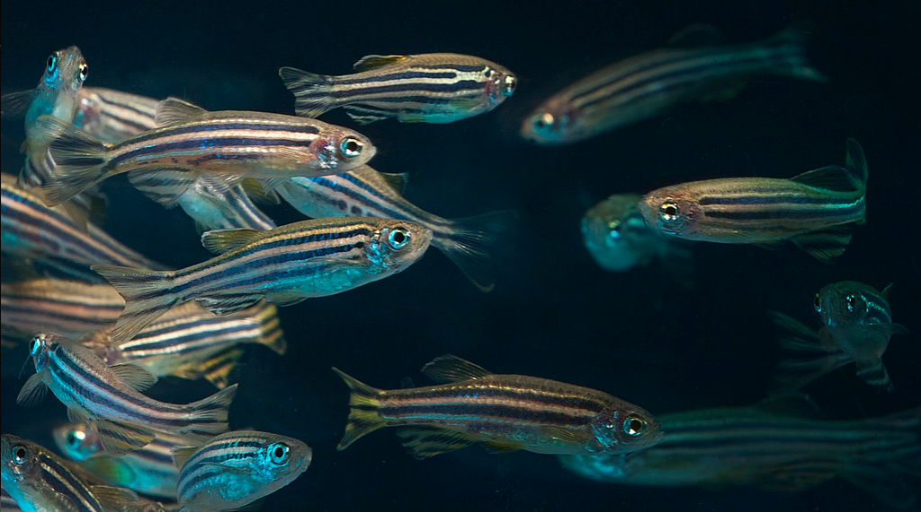
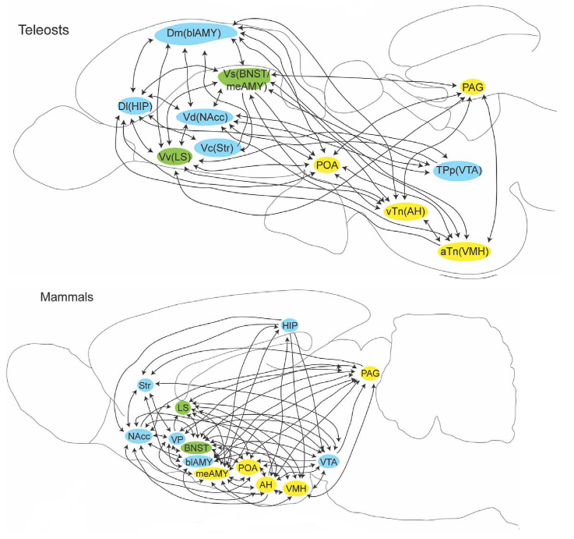
Introduction
Social behavior is crucial for the survival and health of social species, including humans (Holt-Lunstad, 2018). Many neuropsychiatric disorders, such as depression, schizophrenia, and autism spectrum disorders are characterized by social behavior dysfunctions and anxiety disorders (Lowengrub et al., 2015; Spain et al., 2018; Kupferberg and Hasler, 2023).
The present study aimed to determine whether brain neurogenesis pattern within regions of the Social Decision-Making (SDM) network is affected using a zebrafish model of social deficits and high anxiety.
Importantly, SDM network in fish brain is evolutionary conserved.
Oregon State University via Flickr under CC BY-SA 2.0
O'Connell, Hofmann, 2011

Slide 3
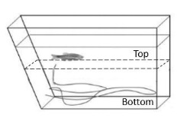
Materials and methods
MK-801, a non-competitive NMDA receptor antagonist, was used to induce social deficit symptoms and altered excitation/inhibition ratio to adult zebrafish, following 7-day treatment. The fish behavior was assessed using, the Novel Tank Test and the Dark Light behavioral Tests. Following MK-801 treatment, BrdU was applied in zebrafish experimental tanks to determine the mitotically active cells. Zebrafish were allowed to survive for 14-16h (Short Term) or 14days (Long Term). BrdU immunohistochemistry was performed and the density of BrdU⁺ mitotically active cells was quantified by microscopic observation within the dorsal nucleus of the ventral telencephalon (Vd), a region suggested to be homologue to the striatum and the nucleus accumbens, a key area of the social decision-making network. Statistical comparisons were conducted between experimental and control groups.
Dark-Light Test (DLT)
Novel Tank Test (NTT)
Danio-rerio, 3–4 months old

Slide 4
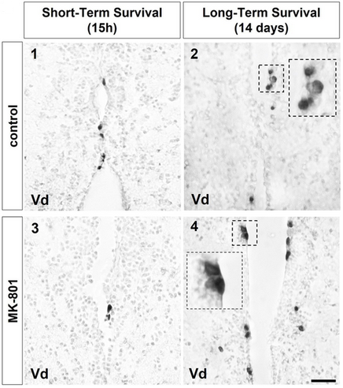
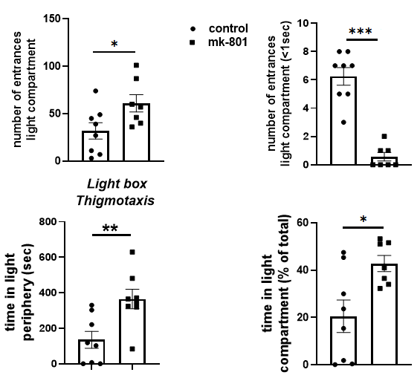
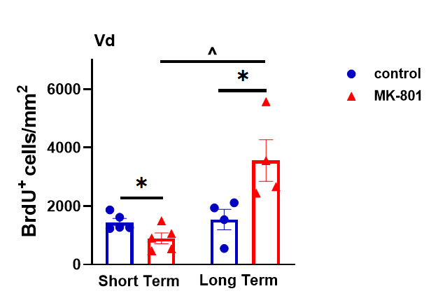
Results
MK-801-treatment significantly decreased cell proliferation rate in Vd, in parallel to social deficits and higher anxiety behavioral profile. Interestingly, this effect was reversed 14 days following the cessation of MK-801 treatment (long survival group), with animals showing reduced levels of anxiety, restoration of social behavior and increased density of newborn cells.
Novel Tank Test (NTT)
Dark-Light Test (DLT)

Slide 5
Discussion
MK-801-induced decreases in adult zebrafish brain neurogenesis may underlie the transient effects on social deficits and anxiety behavioral profile. In support, the normalization of behavioral phenotype, following the cessation of NMDA receptor hypofunction, was associated to increased newborn cell density. Taken all together, our results further support the association of adult neurogenesis to excitation/inhibition imbalance and social behavior.

