Slide 1
Examining the possible correlation among personality dysfunction, pathological traits and internalized stigma in individuals diagnosed with personality disorders
P18
Viktória Pribula¹, Tamara Anikó Renkó^{2,3}, Péter Ruscsák¹, Lívia Priyanka Elek^{2,3}, Gabriella Vizin⁴, Xenia Gonda²
¹Eötvös Loránd University, Institute of Psychology, Budapest
²Semmelweis University, Department of Psychiatry and Psychotherapy, Budapest
³Semmelweis University, Department of Clinical Psychology, Budapest
⁴Eötvös Loránd University, Institute of Psychology, Department of Clinical Psychology and Addiction, Budapest

Slide 2
Background
The transformation of the concept of personality disorders
Classic categorical approach
Dimensional models
ICD-10: 8 personality disorder categories
ICD-11: Mild, moderate and severe personality disorder
DSM-IV: 10 personality disorder categories further grouped into clusters A, B, C
DSM-5 Section III.: The Alternative Model of Personality Disorders (AMPD)  Module I. - Level of Personality Functioning Scale
◆ Module II. - Pathological personality traits
◆ Module III. - Dysfunctions and pathological personality traits associated with each personality disorder category
The DSM-5 Alternative Model of Personality Disorders (AMPD) and the ICD-11 represent a shift in the understanding of personality disorders.
These new classification systems are based on a dimensional concept and identify domains of dysfunction.
Internalised stigma is a risk factor for a worse mental health prognosis.
Dimensional models aid in exploring the background of internalised stigma.

Slide 3
Methods
Goals of the study
To explore:
1. The correlation between the diagnoses obtained from the SCID-5-AMPD and SCID-5-PD structured diagnostic interviews.
2. The relationship between personality dysfunction and internalized stigma (ISMI-10).
3. The impact of demographic characteristics on the relationship between SCID-5-AMPD personality dysfunction level and internalized stigma.
The process of data collection:
Information + Declaration of consent
SCID-5-PD self-report screening questionnaire
ISMI-10 self-report questionnaire
SCID-5-AMPD structured diagnostic interview
SCID-5-PD structured diagnostic interview
Sample: 62 patients with personality disorders hospitalised in an acute psychiatric ward
Measures: SCID-5-AMPD, SCID-5-PD, PDS-ICD-11, ISMI-10
Statistical tests: correlation analysis, linear regression analysis, moderation models

Slide 4
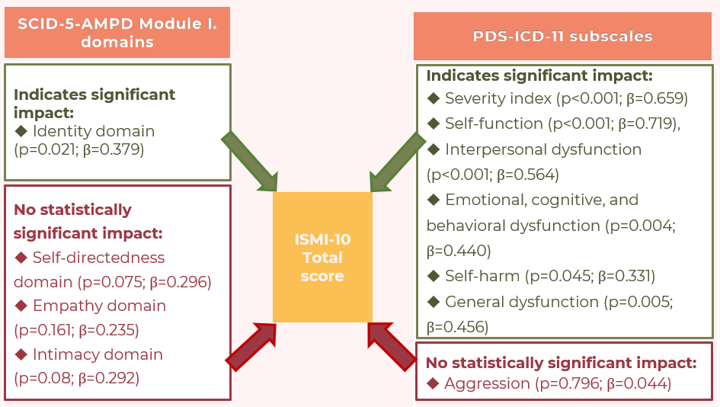
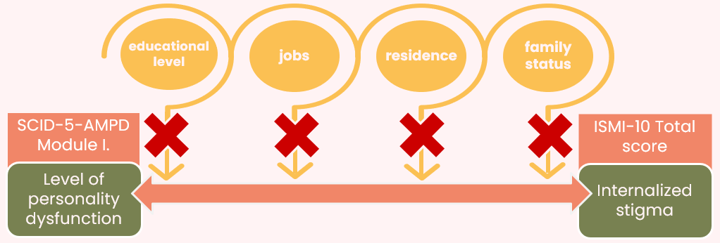
Results
Personality disorders | p-value | r_{tet} (correlation coefficient)
Avoidant | 0,033 | 0,28*
Obsessive-compulsive | 0,149 | 0,19
Narcissistic | 0,733 | -0,03
Borderline | <0,001 | 0,59**
Antisocial | 0,855 | -0,02
Schizotypal | <0,001 | 0,69**
Table 1.: Tetrachoric correlation between SCID-5-AMPD Module III. personality disorder categories and SCID-5-PD personality disorder categories
*p<0.05; **p<0.001 colours are used as a visual indication of the strength of the correlation
Figure 1: Linear regression analysis for the internalised stigma total score
Figure 2.: Moderation analysis: the effect of demographic characteristics on the relationship between level of personality functioning and internalised stigma

Slide 5
Conclusion
P18
The dimensional measures are considered to be indicative of the severity of personality disorders and can provide valuable but partly different diagnostic information
Clinical significance:
The inclusion of dimensional measures can improve the effectiveness of treatment by:
◆ Identifying the pathological traits that underlie the disorder and the areas of impairment in personality functioning personalised psychotherapy
◆ Better capturing the underlying stigma caused by personality disorders
Future plans: comparison of dimensional models with other personality pathology concepts
Thank you for your attention!
Acknowledgement to: Dr. Xenia Gonda, Tamara Aniko Renko, Dr. Gabriella Vizin

