Slide 1
UNDERSTANDING STIGMA ASSOCIATED WITH PERSONALITY DISORDERS TO IMPROVE WELL-BEING OF PATIENTS
P21
Péter Ruscsák¹, Viktória Pribula¹, Fanni Pongrácz¹, Lilien Király¹, Tamara Renkó^{2,3}, Gabriella Vizin^{2,3,4}, Xénia Gonda^{2,3,4}
¹Eötvös Loránd University, Institute of Psychology, Budapest
²Semmelweis University, Department of Psychiatry and Psychotherapy, Budapest
³Semmelweis University, Department of Clinical Psychology, Budapest
⁴Eötvös Loránd University, Institute of Psychology, Department of Clinical Psychology and Addiction, Budapest

Slide 2
Backround and Goals and Methods
The co-existence of conflicting self-representations is a source of tension. As the self that is perceived as flawed or incomplete is revealed to others, so is shame. Shame is a direct cause of reduced well-being and negative, pessimistic, depressive mood symptoms. The tendency to shame is present across personality disorders in people with impaired personality organisation. Self-stigmatisation is inseparable from shame. Self-stigma is not only a consequence of mental disorders but also a risk factor. Self-compassion as a coping mechanism is a protective factor.
HOW DOES PERSONALITY PATHOLOGY DIRECTLY AND INDIRECTLY AFFECT SELF-STIGMATISATION ?
Personality Disorder severity
Internalized Stigma Brief Version
Self-Compassion Scale
Short Form
Experiencing Shame Scale
Patient Health Questionnaire
PDS-ICD-11
ISMI-10
SCS-SF
ESS
PHQ-4
89 PATIENTS WITH PERSONALITY DISORDER(S) & TREATED IN ACUTE PSYCHIATRY DEPARTMENT
PDS-ICD-11, ISMI-10, SCS-SF, ESS, PHQ-4
MEDIATION MODELS

Slide 3
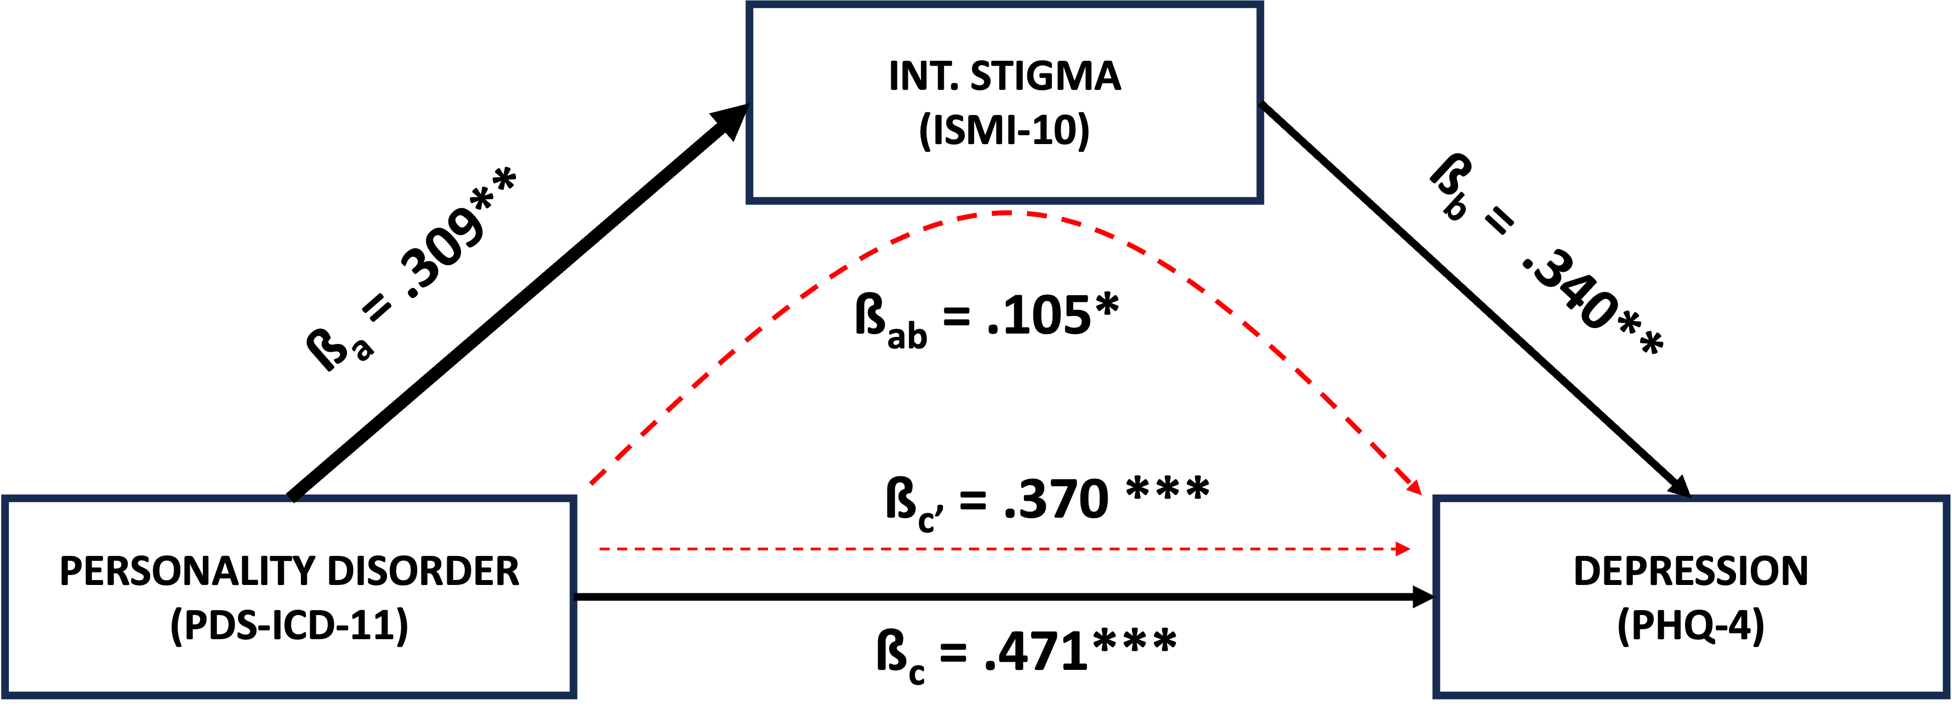
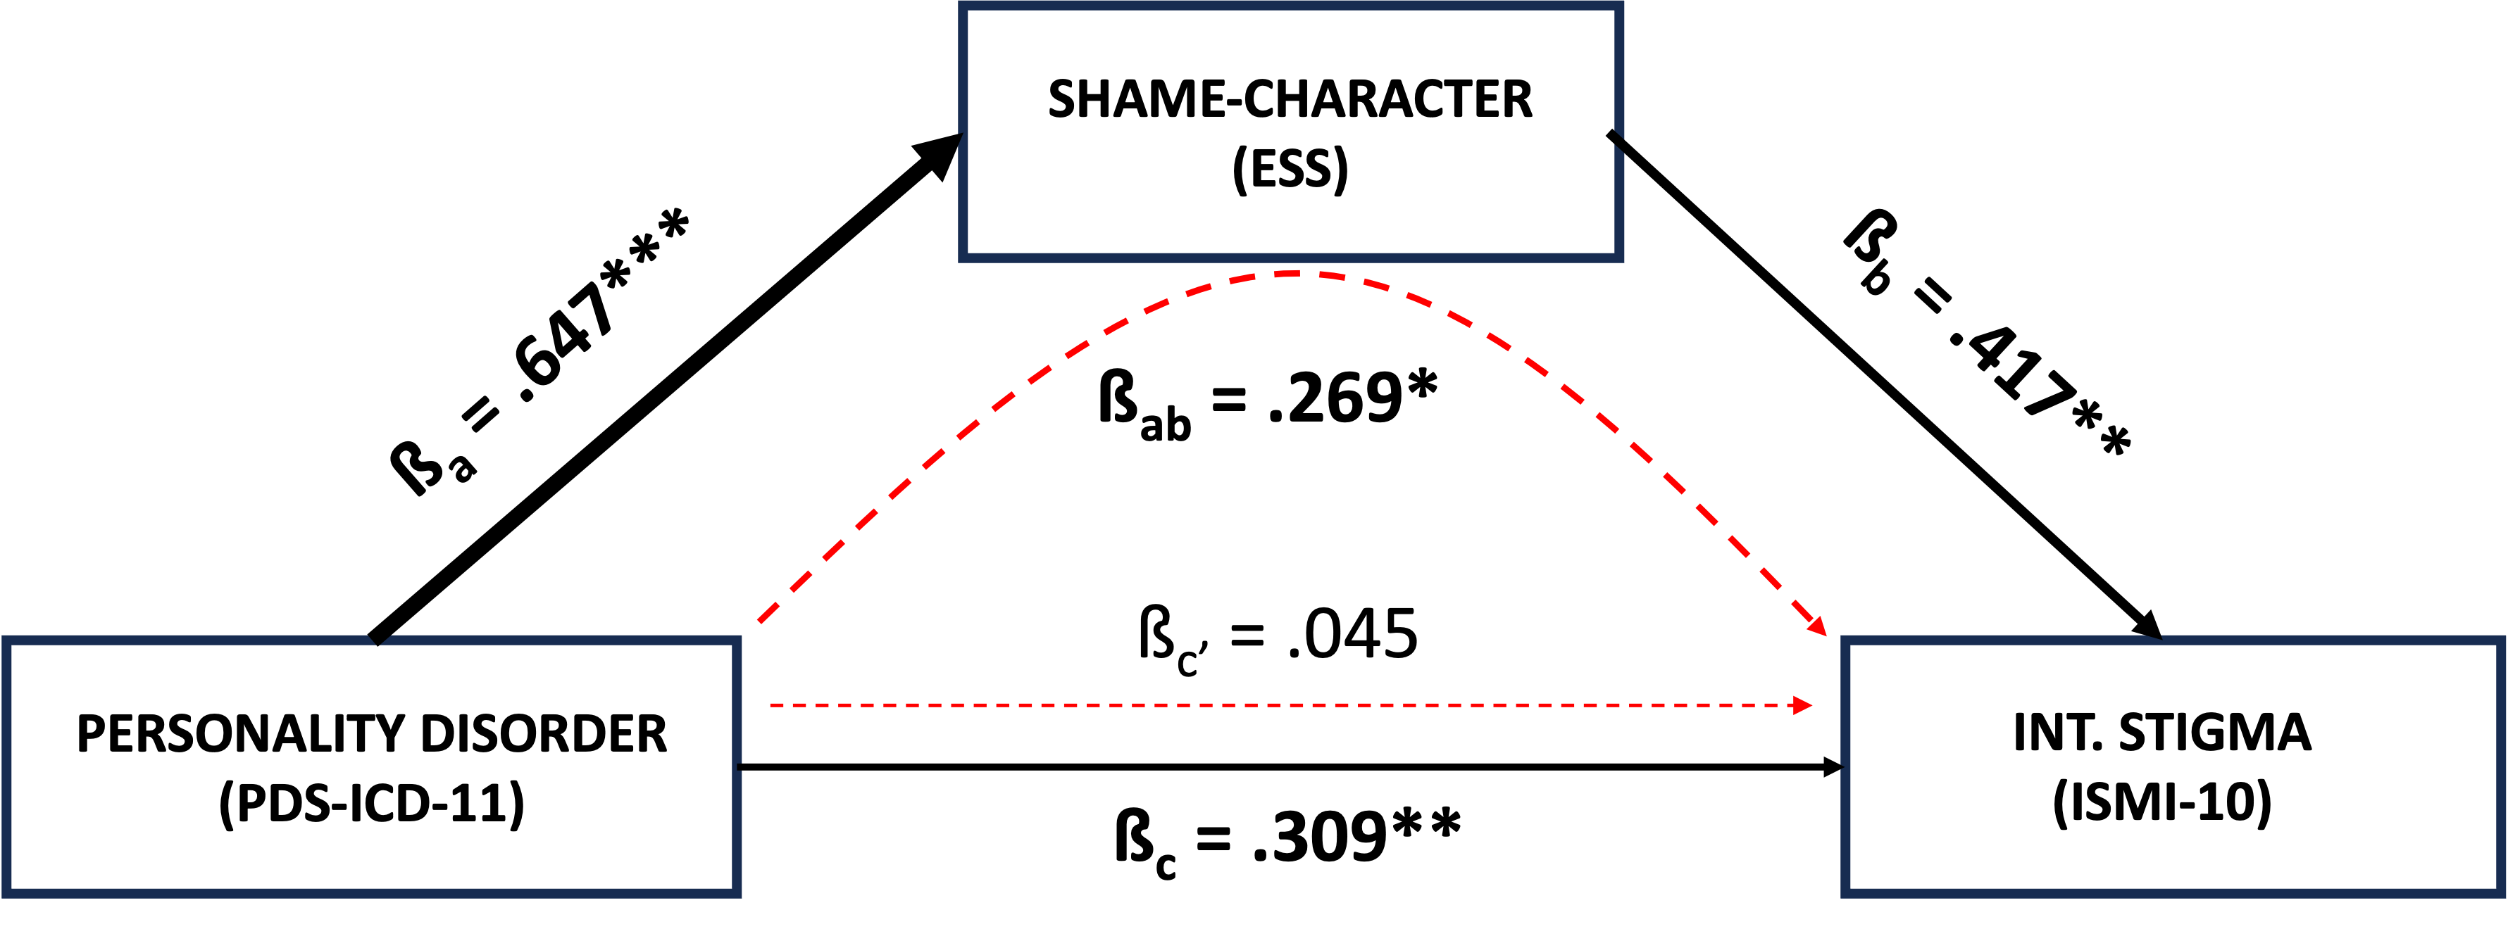
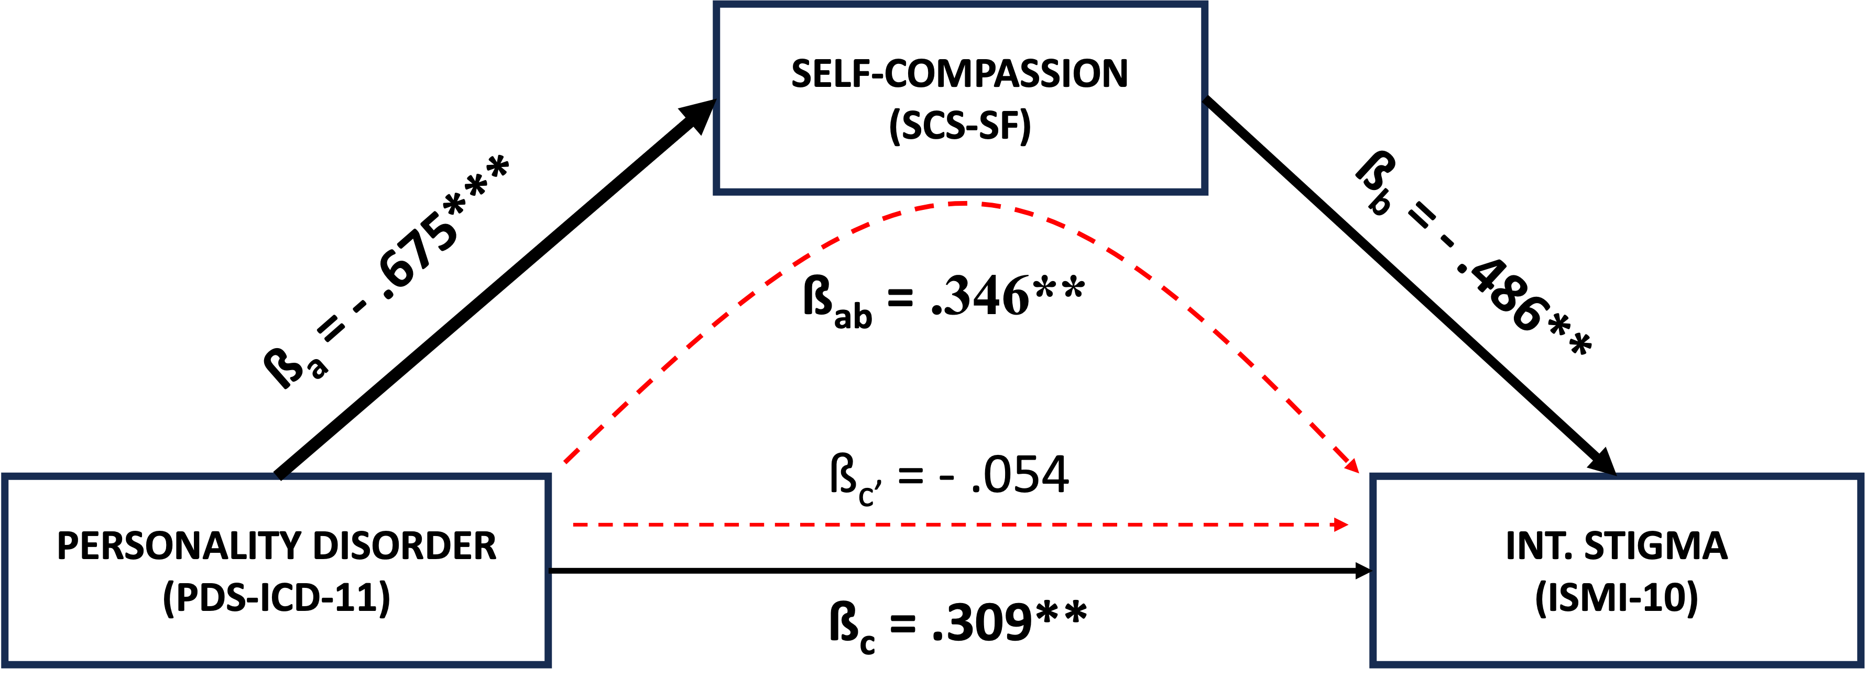
RESULTS

Slide 4
The extent to which internalized stigma severe is, depends not only on the impairment of self-functioning, but also on the tendencies to exhibit a generalized sense of self-compassion or shame. Furthermore, self-stigmatisation is a mediating factor in the effect of personality disorder on depressive traits.
C O N C L U S I O N
Thank you for your attention!
I would especially like to thank Xenia Gonda!

