Slide 1
Demographic features of violent and non-violent suicide samples among treated inpatients between 2016-2021 in Budapest, Hungary
Noemi Szeifert, Barbara Sebők, Xénia Gonda
National Institute of Sports Medicine, Budapest, Hungary
Doctoral School of Psychology, ELTE Eötvös Loránd University, Budapest, Hungary
Semmelweis University School of PhD Studies Workgroup for Science Management
Department of Psychiatry and Psychotherapy, Semmelweis University, Budapest, Hungary
NAP3.0-SE Neuropsychopharmacology Research Group, Hungarian Brain Research Program, Semmelweis University, Budapest, Hungary

Slide 2
Introduction
During the pandemic years in Hungary the completed suicide rate has risen significantly, in contrast to most other countries worldwide. Suicide rates had been decreasing until 2019 since 1986. In 2019, 1550 people dead by suicide, in 2020 this number increased to 1705; in 2021, 1561 and in the year of 2022, 1647 cases were registered. Violent suicide attempts represent the majority of completed suicides. Whereas the registered cases of non-violent suicide attempts had not shown any differences during the pandemic years.

Slide 3
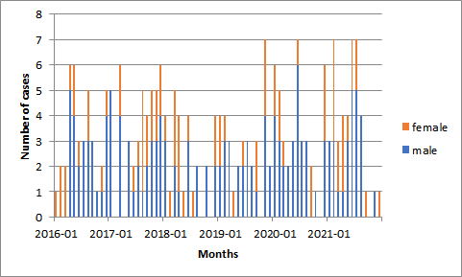
Objective
Our study targeted to evaluate the magnitude of alteration in the number of violent and non-violent suicide attempts between 2016-2021, focusing on the trend in the first two years of the pandemic outbreak, starting from March 2020.

Slide 4
Methods
Psychiatric assessment reports were analyzed of self-poisoning patients admitted to Péterfy Sándor Hospital’s Crisis Intervention and Psychiatric Ward and Clinical Toxicology Unit from January 2016 to December 2021 to estimate the demographic features of non-violent suicide attempters. Patient data were also analysed for violent suicide attempts treated at Dr. Manninger Jenő Trauma Centre, Budapest, Hungary from 2016-2021, focusing on trends during the first two pandemic years. We used an interrupted time-series analysis with Prais-Winsten regression, controlling for autoregressive and seasonal effects, to estimate the effect of the pandemic on the violent and non-violent suicide attempt rates in our sample.

Slide 5
Violent and non-violent suicide attempters 2016-2021 (n=374)

Slide 6
Results and Conclusion
Compared to the previous years, in the first two pandemic years the number of inpatients treated because of violent suicide attempts has risen significantly. After the rapid change in 2020, decreasing numbers could be observed in 2021. More male patients can be found among the victims, and the economically active age group and elderly patients are more affected.
Understanding the effect of the pandemic on the increase of suicide rates by focusing on the associated demographic factors may reveal crucial points for suicide prevention in general and during such potential future global crises.

